Slide 1
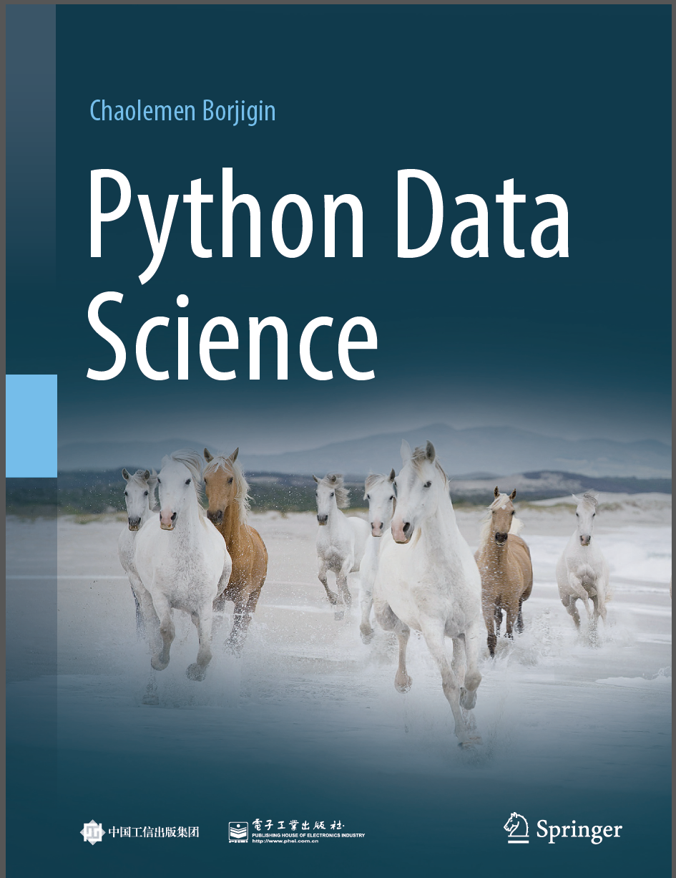
Python Programming —— From Data Analysis to Data Science
Chaolemen Borjigin
Renmin University of China
chaolemen@ruc.edu.cn

Slide 2
5.1 Statistical modelling with statsmodels
Chaolemen Borjigin
Renmin University of China
chaolemen@ruc.edu.cn

Slide 3
Summary of this chapter
▼Chapter 5 Data analysis with Python
► 5.1 Statistical modelling with statsmodels
5.1.1 Business understanding
5.1.2 Data loading
5.1.3 Data understanding
5.1.4 Data wrangling
5.1.5 Model selection and hyperparameter tuning

Slide 4
Summary of this chapter
▼Chapter 5 Data analysis with Python
► 5.1 Statistical modelling with statsmodels
5.1.6 Fitting model and summarizing the Regression Results
5.1.7 Model evaluation
5.1.8 Assumptions testing
5.1.9 Model optimization and re-selection
5.1.10 Model application

Slide 5
5.1.1 Business understanding
▼Chapter 5 Data analysis with Python
► 5.1 Statistical modelling with statsmodels
In this chapter, the business objective is to analyze the relationship between women’s height and women’s weight, in other words, predict a woman’s weight by her height. The original data are obtained from The World Almanac and Book of Facts (1975). This data set gives the average heights and weights for American women aged 30–39. It is a data frame with 15 observations on 2 variables. It is structured as a data frame with 15 observations on 2 variables. • women[,1]:height(in):numeric
• women[,2]:weight (lbs):numeric

Slide 6
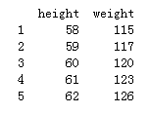
5.1.2 Data loading
▼Chapter 5 Data analysis with Python
► 5.1 Statistical modelling with statsmodels
In[3]:
import os
os.chdir(r'C:\Users\soloman\clm')
print(os.getcwd())
C:\Users\soloman\clm
In[4]:
import pandas as pd
import numpy as np
df_women = pd.read_csv('women.csv', index_col=0)
print(df_women.head())

Slide 7
5.1.3 Data understanding
▼Chapter 5 Data analysis with Python
► 5.1 Statistical modelling with statsmodels
In[5]:
df_women.shape
Out[5]:
(15, 2)
In[6]:
print(df_women.columns)
Out[6]:
Index(['height', 'weight'], dtype='object')

Slide 8
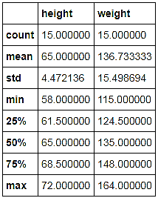
5.1.3 Data understanding
▼Chapter 5 Data analysis with Python
► 5.1 Statistical modelling with statsmodels
In[7]:
df_women.describe()
Out[7]:

Slide 9
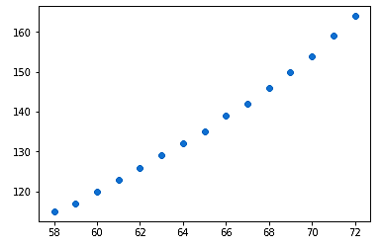
5.1.3 Data understanding
▼Chapter 5 Data analysis with Python
► 5.1 Statistical modelling with statsmodels
In[8]:
import matplotlib.pyplot as plt
%matplotlib inline
plt.scatter(df_women["height"], df_women["weight"])
plt.show()
Out[8]:

Slide 10
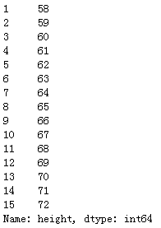
5.1.4 Data wrangling
▼Chapter 5 Data analysis with Python
► 5.1 Statistical modelling with statsmodels
In[9]:
X = df_women["height"]
y = df_women["weight"]
In[10]:
X
Out[10]:

Slide 11
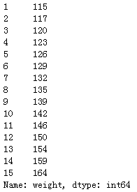
5.1.4 Data wrangling
▼Chapter 5 Data analysis with Python
► 5.1 Statistical modelling with statsmodels
In[11]:
y
Out[11]:

Slide 12
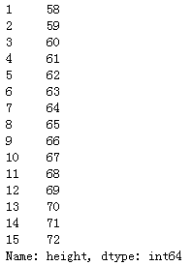
5.1.5 Model selection and hyperparameter tuning
▼Chapter 5 Data analysis with Python
► 5.1 Statistical modelling with statsmodels
In[12]:
import statsmodels.api as sm
In[13]:
X
Out[13]:

Slide 13
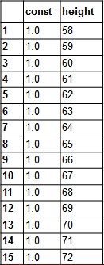
5.1.5 Model selection and hyperparameter tuning
▼Chapter 5 Data analysis with Python
► 5.1 Statistical modelling with statsmodels
X_add_const=sm.add_constant(X)
X_add_const
In[14]:
Out[14]:
In[15]:
myModel = sm.OLS(y, X_add_const)

Slide 14
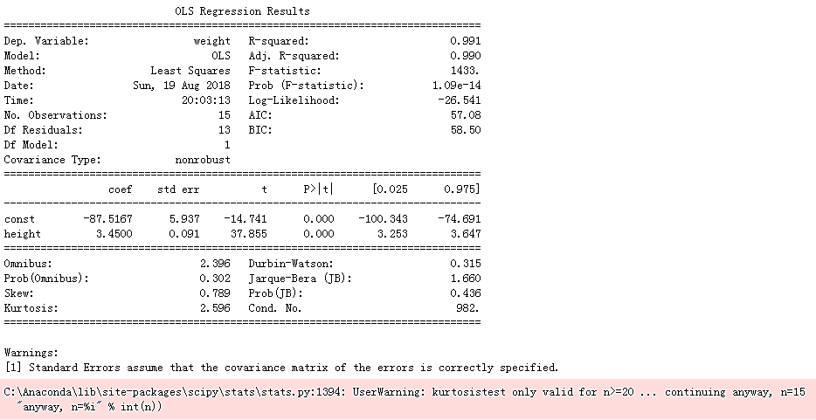
5.1.6 Fitting model and summarizing the Regression Results
▼Chapter 5 Data analysis with Python
► 5.1 Statistical modelling with statsmodels
results = myModel.fit()
print(results.summary())
In[16]:

Slide 15
5.1.6 Fitting model and summarizing the Regression Results
▼Chapter 5 Data analysis with Python
► 5.1 Statistical modelling with statsmodels
In[17]:
results.params
const -87.516667
height 3.450000
dtype: float64
Out[17]:

Slide 16
5.1.7 Model evaluation
▼Chapter 5 Data analysis with Python
► 5.1 Statistical modelling with statsmodels
In[18]:
results.rsquared
Out[18]:
0.9910098326857505

Slide 17
5.1.8 Assumptions testing
▼Chapter 5 Data analysis with Python
► 5.1 Statistical modelling with statsmodels
In[20]:
results.f_pvalue
Out[20]:
1.0909729585997682e-14
In[21]:
sm.stats.stattools.durbin_watson(results.resid)
Out[21]:
0.3153803748621851

Slide 18
5.1.8 Assumptions testing
▼Chapter 5 Data analysis with Python
► 5.1 Statistical modelling with statsmodels
In[22]:
sm.stats.stattools.jarque_bera(results.resid)
Out[22]:
(1.6595730644309743,
0.4361423787323869,
0.7893583826332262,
2.5963042257390008)

Slide 19
5.1.8 Assumptions testing
▼Chapter 5 Data analysis with Python
► 5.1 Statistical modelling with statsmodels
In[23]:
y_predict=results.predict()
y_predict
array([112.58333333, 116.03333333, 119.48333333, 122.93333333,
126.38333333, 129.83333333, 133.28333333, 136.73333333,
140.18333333, 143.63333333, 147.08333333, 150.53333333,
153.98333333, 157.43333333, 160.88333333])
Out[23]:

Slide 20
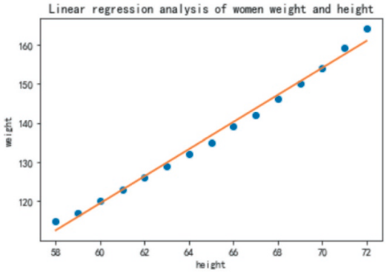
5.1.9 Model optimization and re-selection
▼Chapter 5 Data analysis with Python
► 5.1 Statistical modelling with statsmodels
In[24]:
plt.rcParams['font.family']="simHei"
plt.plot(df_women["height"], df_women["weight"],"o")
plt.plot(df_women["height"], y_predict)
plt.title('Linear regression analysis of women's weight and height')
plt.xlabel('height')
plt.ylabel('weight')
Out[24]:
Text(0,0.5,‘weight')

Slide 21
5.1.9 Model optimization and re-selection
▼Chapter 5 Data analysis with Python
► 5.1 Statistical modelling with statsmodels
In[26]:
import pandas as pd
import numpy as np
df_women = pd.read_csv('women.csv', index_col=0)
X = df_women["height"]
y = df_women["weight"]
X=np.column_stack((X, np.power(X,2), np.power(X,3)))

Slide 22
5.1.9 Model optimization and re-selection
▼Chapter 5 Data analysis with Python
► 5.1 Statistical modelling with statsmodels
In[27]:
X_add_const=sm.add_constant(X)
X_add_const
array([[1.00000e+00, 5.80000e+01, 3.36400e+03, 1.95112e+05],
[1.00000e+00, 5.90000e+01, 3.48100e+03, 2.05379e+05],
[1.00000e+00, 6.00000e+01, 3.60000e+03, 2.16000e+05],
[1.00000e+00, 6.10000e+01, 3.72100e+03, 2.26981e+05],
[1.00000e+00, 6.20000e+01, 3.84400e+03, 2.38328e+05],
[1.00000e+00, 6.30000e+01, 3.96900e+03, 2.50047e+05],
[1.00000e+00, 6.40000e+01, 4.09600e+03, 2.62144e+05],
[1.00000e+00, 6.50000e+01, 4.22500e+03, 2.74625e+05],
[1.00000e+00, 6.60000e+01, 4.35600e+03, 2.87496e+05],
[1.00000e+00, 6.70000e+01, 4.48900e+03, 3.00763e+05],
[1.00000e+00, 6.80000e+01, 4.62400e+03, 3.14432e+05],
[1.00000e+00, 6.90000e+01, 4.76100e+03, 3.28509e+05],
[1.00000e+00, 7.00000e+01, 4.90000e+03, 3.43000e+05],
[1.00000e+00, 7.10000e+01, 5.04100e+03, 3.57911e+05],
[1.00000e+00, 7.20000e+01, 5.18400e+03, 3.73248e+05]])
Out[27]:

Slide 23
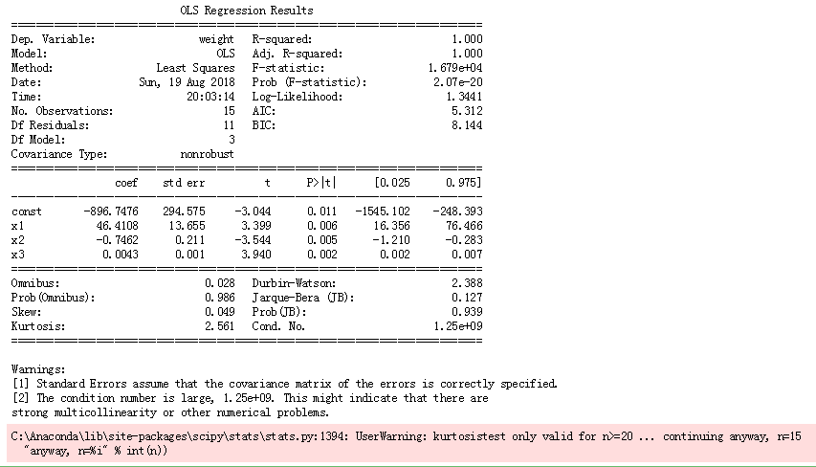
5.1.9 Model optimization and re-selection
▼Chapter 5 Data analysis with Python
► 5.1 Statistical modelling with statsmodels
In[28]:
myModel_updated = sm.OLS(y, X_add_const)
In[29]:
results_updated = myModel_updated.fit()
print(results_updated.summary())

Slide 24
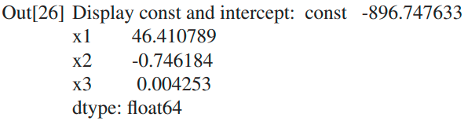
5.1.9 Model optimization and re-selection
▼Chapter 5 Data analysis with Python
► 5.1 Statistical modelling with statsmodels
In[30]:
print('Display const and intercept:',results_updated.params)
In[31]:
y_predict_updated=results_updated.predict()
y_predict_updated
array([114.63856209, 117.40676937, 120.18801264, 123.00780722,
125.89166846, 128.86511168, 131.95365223, 135.18280543,
138.57808662, 142.16501113, 145.9690943 , 150.01585147,
154.33079796, 158.93944911, 163.86732026])
Out[31]:

Slide 25
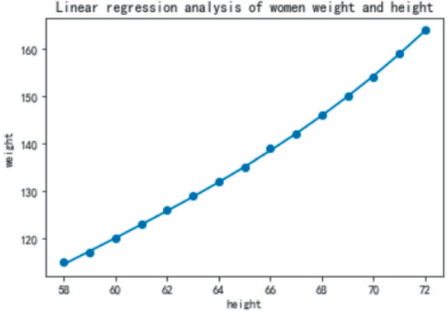
5.1.9 Model optimization and re-selection
▼Chapter 5 Data analysis with Python
► 5.1 Statistical modelling with statsmodels
plt.rcParams['font.family']="simHei" plt.scatter(df_women["height"], df_women["weight"])
plt.plot(df_women["height"], y_predict_updated)
plt.title('Linear regression analysis of women weight and height')
plt.xlabel('height')
plt.ylabel('weight')
In[32]:
Text(0,0.5, 'weight')
Out[32]:

Slide 26
5.1.10 Model application
▼Chapter 5 Data analysis with Python
► 5.1 Statistical modelling with statsmodels
h=63.5
results_updated.predict([1,h,np.power(h,2),np.power(h,3)])
In[33]:
array([130.39340008])
Out[33]:

Slide 27


